Slide 1

Lab 6 - Morse Code Lab
Morse Code Lab
Write a MSP430 assembly program that outputs a message in Morse Code using the red LED and the eZ430X transducer (magnetic buzzer)
  Define .set variables for DOT, DASH, and spacing counts in terms of Morse Code elements
  For 5 words per minute, each element should be 240 milli-seconds
Configure the watchdog as an interval timer and write an interrupt service routine (ISR) to pulse the transducer device creating a tone using pulse width modulation (PWM)
Also, blink the eZ430-RF2500 green LED on and off at one second intervals
BYU CS/ECEn 124
Morse Code Lab

Slide 2
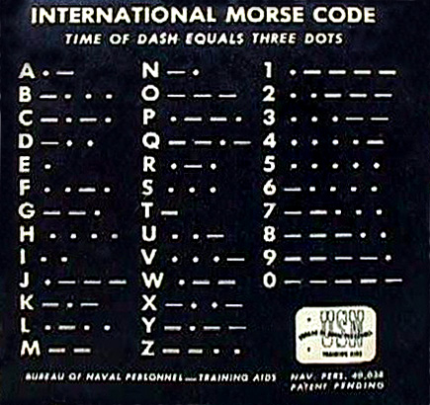
Lab 5 - Morse Code Lab
Morse Code
•••• • • •• • •• • • • • •• ••
BYU CS/ECEn 124
Morse Code Lab

Slide 3
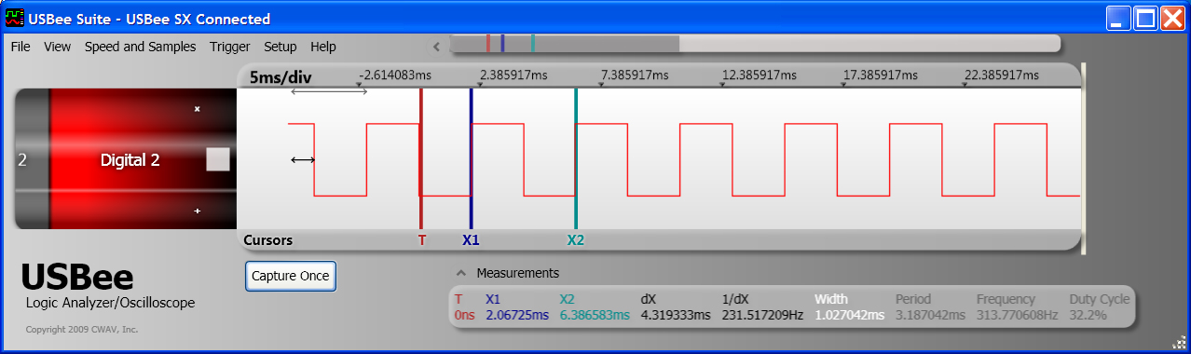


Duty Cycles
Tone Scale Example
BYU CS/ECEn 124
Morse Code Lab

Slide 4
Timing Calculations
myClock = 1,200,000 clocks/sec ≈ 1/1,200,000 sec/clock
WDT_CLK = 500 clocks
Watchdog timer will count up from 0 to 500.
Watchdog timer request an interrupt when it reach full count and then timer counter resets to 0.
This generates one interrupt every 500 clocks (frequency).
500 clocks × 1/1,200,000 sec / clock
= 500/1,200,000 sec / interrupt
= 0.416667 mSec / Interrupt
How many interrupts for 1 Sec?
≈ 1,200,000/500 = 2400 interrupts / second
≈ myClock/WDT_CLK interrupts / second
BYU CS/ECEn 124
Morse Code Lab

Slide 5
One Second Interval
frequency
|||||||||||||||||||||||||||||||||.................................... ||||||||||| 1,200,000 clocks/sec
|||...||||...||||...||||...||||...||||...|............|||...||||...||||...||||...| 1 interrupt / 500 Clocks
|.......................................................................................... | 1,200,000/500 int./sec
Interrupt is served every 500 clocks
WDT_ISR:
bit.w #0x0200,&WDTSecCnt ; << remove/replace >>
jeq WDT_02 ; << remove/replace >>
xor.b #0x20,&P4OUT ; use 50% PWM
WDT_02:
dec.w &WDTSecCnt ; decrement counter, 0?
jne WDT_04 ; n
mov.w #WDT_CPS,&WDTSecCnt ; y, re-initialize counter xor.b #0x01,&P1OUT ; toggle P1.0
WDT_04:
reti ; return from interrupt
Toggles every 2400 interrupts = 1 second
BYU CS/ECEn 124
Morse Code Lab

Slide 6
240 mSec
frequency
|||||||||||||||||||||||||||||||||.................................... ||||||||||| 1,200,000 clocks/sec
|||...||||...||||...||||...||||...||||...|............|||...||||...||||...||||...| 1 interrupt / 500 Clocks
|.......................................................................................... | 1,200,000/500 int./sec
500 clocks × 1/1,200,000 sec / clock
= 500/1,200,000 sec / interrupt
= 0.416667 mSec / Interrupt
How many interrupts for 240 mSec (one element)?
240 mSec / 0.416667 mSec / Interrupt
= 576 interrupts / element
BYU CS/ECEn 124
Morse Code Lab

Slide 7
WDT_ISR:
decrement count = number of elements × 576
if count > count for 1 element (576)
keep red LED on
toggle buzzer for 50% duty cycle
else if count > 0
turn off red LED
keep buzzer off
WDT_02:
dec.w &WDTSecCnt ; decrement counter, 0?
jne WDT_04 ; n
mov.w #WDT_CPS,&WDTSecCnt ; y, re-initialize counter xor.b #0x01,&P1OUT ; toggle P1.0
WDT_04:
reti ; return from interrupt
BYU CS/ECEn 124
Morse Code Lab

Slide 8
Main Loop
main_loop
get base address of message mov.w #message, R5
new_message
read message mov.w @R5+, R6
if (message == END)
load counters for END
else if (message == DOT)
load counters for DOT
else if (message == DASH)
load counters for DASH
else if (message == SPACE)
load counters for SPACE
else if (message == END_MSG)
go to main_loop
wait till counter reaches 0
go to new_message
BYU CS/ECEn 124
Morse Code Lab

